Slide 1
Tutorial

Slide 2
Using a model
Introduce model, data, parameters
Run baseline simulation and create epidemic curves
Modify transmission/recovery
Modify mobility

Slide 3
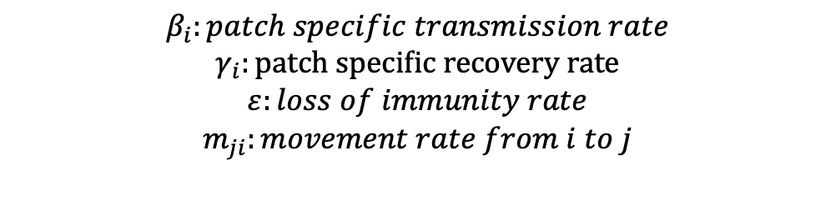
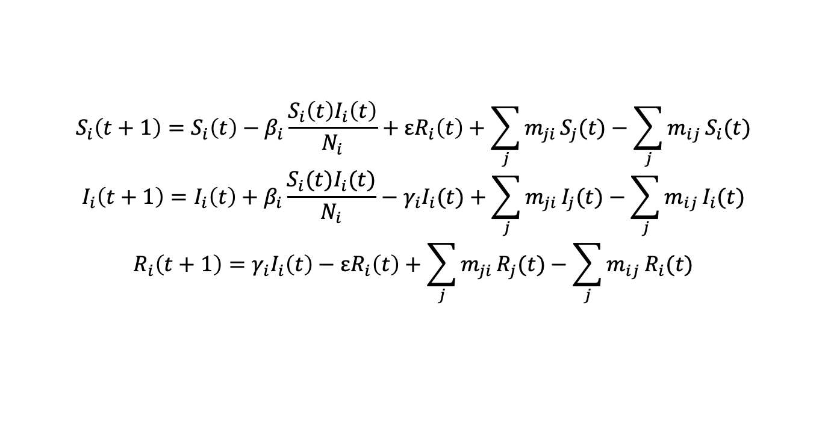
Using a Model
The model we are working with is a directly-transmitted SIRS model
Eulerian movement
Many respiratory diseases, including COVID-19, influenza
$$S_{i}\left(t+1\right)=S_{i}\left(t\right)−β_{i}\frac{S_{i}\left(t\right)I_{i}\left(t\right)}{N_{i}}+εR_{i}\left(t\right)+\sum_{j}^{​}{m_{ji}}S_{j}(t)−\sum_{j}^{​}{m_{ij}}S_{i}(t)$$
$$I_{i}\left(t+1\right)=I_{i}\left(t\right)+β_{i}\frac{S_{i}(t)I_{i}(t)}{N_{i}}−γ_{i}I_{i}(t)+\sum_{j}^{​}{m_{ji}}I_{j}(t)−\sum_{j}^{​}{m_{ij}}I_{i}(t)$$
$$R_{i}\left(t+1\right)=γ_{i}I_{i}\left(t\right)−εR_{i}\left(t\right)+\sum_{j}^{​}{m_{ji}}R_{j}(t)−\sum_{j}^{​}{m_{ij}}R_{i}(t)$$
$$β_{i}:patch specific transmission rate$$
$$γ_{i}:patch specific recovery rate$$
$$ε:loss of immunity rate$$
$$m_{ji}:movement rate from i to j$$

Slide 4
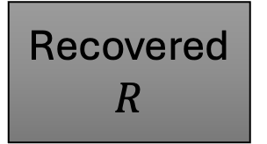
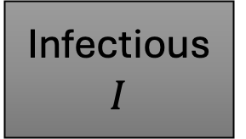
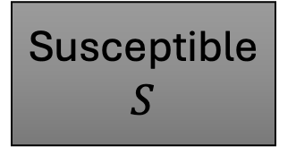

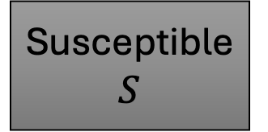
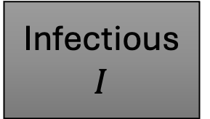
Steps to the model
Initialize a human population
How many patches? How many people in each patch? Who is initially infected?
Use mobility data to create adjacency matrix
Begin simulation
Infection/recovery are separate steps from movement
Within-patch transmission, then between-patch movement
Human population object changes; use this to plot epidemic curve etc
Susceptible $S$
Infectious $I$
Recovered $R$
Susceptible $S$
Infectious $I$
Recovered $R$

Slide 5
Step 1: Run baseline
First, create human population object
Define landscape, named “pat_locator”
InitiatePop() is then used to create human population object
Use mobility data to create adjacency matrix
Then, run the baseline simulation
runSim()
Then, use some of the plotting functions on the final human population object
Plot_total_curve()
Plot_patch_curves()
Plot_map_day()

Slide 6
Working with the data
Data is provided as number of people traveling from one place to another, out of a total population
Use this to create a matrix
Can create off-diagonal movement rates
This may be too high (people may take multiple trips, getting double counted); can use a multiplier to reduce
Then, we fill in the diagonal
origin dest. movers users
Montgomery Roanoke 42 1200
Montgomery Fairfax 12 1200
Roanoke Montgomery 55 1800
Fairfax Montgomery 8 3600
M[i,j] = moversᵢⱼ / usersᵢ
M[i,i] = 1 − sum(M[i,−i])
movement_matrix <- matrix(0, n_patches, n_patches)
movement_matrix[cbind(fr_pat, to_pat)] <- movers / fr_users
movement_matrix <- movement_matrix * 0.1 * movement_multiplier
diag(movement_matrix) <- 1 - rowSums(movement_matrix)

Slide 7
Option 1: Start changing epidemiological parameters
First, we will change factors across the entire landscape (global parameters)
What happens if the transmission rate of the disease changes?
# Since gamma = 1/6, beta/gamma is approximately R0.
# Baseline: beta/gamma = 2
lower_R0 <- simulate_scenario(
beta = 1.2/6,
gamma = 1/6,
days = 120
)
plot_total_curve(lower_R0,
"Lower transmission: R0 approximately 1.2")

Slide 8
Option 2: Modify mobility
no_mobility <- simulate_scenario(movement_multiplier = 0, days = 120)
high_mobility <- simulate_scenario(movement_multiplier = 0.25, days = 120)
compare_mobility <- rbind(
data.frame(no_mobility$epidemic_curve, scenario = "No mobility"),
data.frame(baseline$epidemic_curve, scenario = "Baseline mobility"),
data.frame(high_mobility$epidemic_curve, scenario = "High mobility")
)
ggplot(compare_mobility, aes(day, inf, linetype = scenario)) +
geom_line(linewidth = 1) + theme_bw(base_size = 16)
What happens if overall movement rates change?
Two scenarios: no mobility at all, and then higher than original levels of mobility

Slide 9
Option 3: Spatial targeting
target_source <- simulate_scenario(
seed_county = "Montgomery",
intervention_counties = "Montgomery",
beta_reduction = 0.5,
days = 120
)
compare_intervention <- rbind(
data.frame(baseline$epidemic_curve, scenario = "No intervention"),
data.frame(target_source$epidemic_curve, scenario = "Reduce beta in source county")
)
ggplot(compare_intervention, aes(day, inf, linetype = scenario)) +
geom_line(linewidth = 1) + theme_bw(base_size = 16)
Reduce transmission in certain counties

